Slide 1
Plan, Schedule, Test Community Portal
Module Project
Module: NICF Capstone Project using Java
Course: NICF Advanced Certificate in Software & Applications (Development & Deployment)
Start Date : 11 April 2022
End Date : 13 May 2022
Submission Date : 14 May 2022
Learner Name : Joshua Ho Gwok Hin
Enrollment ID :
Presentation Date : May 2022

Slide 2
Contents
Document History
Version Number | Effective Date of release | Summary of Included Changes | Author
1 | 4th March 2016 | First Edition | Satya CVS
2 | 23rd Jul 2018 | Changed for Module 6 | Shrinivas K R

Slide 3
Contents
Contents
S. No. | Description
01 | Different Types of Testing
02 | How Different Testing Helps
03 | Tests Selected
04 | Test Schedule
05 | Test Results
06 | Testing Tools
07 | Project Milestone & Tasks
08 | Milestone Feedback & Action Taken
09 | Modifications Made Based on Feedback
10 | Project Results
11 | Proposed Improvements

Slide 4
1. Different Types of Testing
Types of Testing | Functional/ Non-functional | Brief description & it’s utility
Unit testing | Functional | Each Module/component is tested. Ensure functional correctness and completeness of individual program units. Scope is smaller, easier to fix errors.
Integration testing | Functional | Testing interconnectivity between the different components in a system. Helps expose faults in the interaction between integrated units. Required test environment to be set up for the test. Ensure all high prioritized bugs are fixed and closed.
System testing | Functional | Testing of a complete and fully integrated software product. Enables to test, verify and validate the business requirements and applications. Application is tested to verify the technical and functional specifications.
System testing Usability testing | Non-functional | Focuses on users ease of use of the application, flexibility in handling controls and that the ability of the system to meet its objectives.
System testing Regression testing | Functional | Retesting previously tested components to ensure proper functionality after modification in a part of system.
System testing Recovery testing | Non-functional | Demonstrates a software solution is reliable and trustful.
System testing Stress testing | Non-functional | Used to test the stability & reliability of the system. Stress tests helps determine the limit of where a system software or hardware breaks, the system robustness and error handling in heavy load condition. Provides effective error management under extreme conditions.

Slide 5
1. Different Types of Testing
System testing Load testing | Non-functional | Determines a systems performance under real-life load conditions. Provides application behaviour when multiple users access it simultaneously. Load testing helps identifies max operating capacity, current infrastructure sufficiency, sustainability of app with respect to peak user load, number of users an app can support and how scalable to allow more users to access.
Interface testing | Functional | Interfaces between system components are tested. Ensure absence of incorrect mapping of data. Interfaces are tested in two phases. Individually during system testing and tested together during integration testing. Can help identify user-friendliness and verify security requirements while communication propagates between the systems.
Cross browser test | Non -functional | Consistency in display and functionality across different browsers.
Acceptance testing | Functional | Validate the end to end business flow that no critical defects and business process works satisfactorily.
Acceptance testing Internal (Alpha) | Functional | Performed by members of the organisation that developed the software but who are not directly involved in the project.
Acceptance testing External (Beta)/UAT | Functional | Performed at client location by people who are not employees of the organisation that developed the software.

Slide 6
2. How Different Test Helps
Types of Testing | Functional/ Non-functional | Brief description & it’s utility
Unit testing | Functional | Each Module/component is tested. Ensure functional correctness and completeness of individual program units. Scope is smaller, easier to fix errors.
Integration testing | Functional | Testing interconnectivity between the different components in a system. Helps expose faults in the interaction between integrated units. Required test environment to be set up for the test. Ensure all high prioritized bugs are fixed and closed.
System testing | Functional | Testing of a complete and fully integrated software product. Enables to test, verify and validate the business requirements and applications. Application is tested to verify the technical and functional specifications.
System testing Usability testing | Non-functional | Focuses on users ease of use of the application, flexibility in handling controls and that the ability of the system to meet its objectives.
System testing Regression testing | Functional | Retesting previously tested components to ensure proper functionality after modification in a part of system.
System testing Recovery testing | Non-functional | Demonstrates a software solution is reliable and trustful.
System testing Stress testing | Non-functional | Used to test the stability & reliability of the system. Stress tests helps determine the limit of where a system software or hardware breaks, the system robustness and error handling in heavy load condition. Provides effective error management under extreme conditions.

Slide 7
2. How Different Test Helps
System testing Load testing | Non-functional | Determines a systems performance under real-life load conditions. Provides application behaviour when multiple users access it simultaneously. Load testing helps identifies max operating capacity, current infrastructure sufficiency, sustainability of app with respect to peak user load, number of users an app can support and how scalable to allow more users to access.
Interface testing | Functional | Interfaces between system components are tested. Ensure absence of incorrect mapping of data. Interfaces are tested in two phases. Individually during system testing and tested together during integration testing. Can help identify user-friendliness and verify security requirements while communication propagates between the systems.
Cross browser test | Non -functional | Consistency in display and functionality across different browsers.
Acceptance testing | Functional | Validate the end to end business flow that no critical defects and business process works satisfactorily.
Acceptance testing Internal (Alpha) | Functional | Performed by members of the organisation that developed the software but who are not directly involved in the project.
Acceptance testing External (Beta)/UAT | Functional | Performed at client location by people who are not employees of the organisation that developed the software.

Slide 8
3. Tests Selected
Use Case Ref | Function/Page | Functional Test | Non-functional Test
UC01 | Login | Unit Testing, UAT | Usability testing, Cross browser testing
UC02 | Register | Unit Testing, UAT | Usability testing, Cross browser testing
UC03 | View own Profile | Unit Testing, UAT | Usability testing, Cross browser testing
UC04 | Update own Profile | Unit Testing, UAT | Usability testing, Cross browser testing
UC05 | Search other users’ profile | Unit Testing, UAT | Usability testing, Cross browser testing
UC06 | View other user’s Public Profile | Unit Testing, UAT | Usability testing, Cross browser testing
UC07 | Password reset |  | Usability testing

Slide 9
3. Tests Selected
Usability testing (Non-functional)
Focuses in the users ease of use of the application, flexibility in handling controls and the ability of the system to meet its objectives.
Helps understand how real users interact with the Web Application and make design changes based on the results. It helps discover undesirable designs even before the actual development of the project.
USABILITY TESTING
Use Case Id | Use Case | Benefits
UST01 | Login | Login design is understood and perform with ease
UST02 | Register | Logical layout of fields, user are not confused
UST03 | View own Profile | User able to figure out how to view own profile
UST04 | Update own Profile | Ensure update of profile task can be accomplished easily
UST05 | Search other users’ profile | Design is intuitive and simple for search function
UST06 | View other user’s Public Profile | User can instinctively view a profile after search results.
UST07 | Password reset | Flow of events are logical without confusion

Slide 10
3. Tests Selected
Unit testing (Functional)
Each Module/component is tested. Ensure functional correctness and completeness of individual program units. Scope is smaller, easier to fix errors.
More reliable code and less time to find and fix the bugs. Unit tests are easier to debug and only the latest changes need to be debugged if the test fails.
UNIT TESTING
Use Case Id | Use Case | Benefits
UNT01 | Login | Scope is smaller, easier to fix errors
UNT02 | Register | Scope is smaller, easier to fix errors
UNT03 | View own Profile | Scope is smaller, easier to fix errors
UNT04 | Update own Profile | Scope is smaller, easier to fix errors

Slide 11
3. Tests Selected
Cross browser testing (Non-functional)
Consistency in display and functionality across different browsers.
Ensure design and functionality is working satisfactory across browsers.
CROSS BROWSER TESTING
Test Case ID | Pages | Benefits
CBT01 | index.jsp | Layout and functions work across browsers
CBT02 | login.jsp | Layout and functions work across browsers
CBT03 | home.jsp | Layout and functions work across browsers
CBT04 | searchUsers.jsp | Layout and functions work across browsers

Slide 12
3. Tests Selected
User acceptance testing (Functional)
Performed at client location by people who are not employees of the organisation that developed the software.
Ensure business process works satisfactorily and met Service-level agreement.
USER ACCEPTANCE TESTING
Use Case Ref | Use Case | Benefits
UAT01 | Software Engineers | Users are able to verify that login feature is working
UAT02 | Network Administrators | Users are able to test that register feature is working

Slide 13
4. Test Schedule
TEST SCHEDULE
Test Schedule ID | 01
Product Name | ABC Jobster Community Portal
Product Version | Jobster 1.0
Present owner | Joshua Ho Gwok Hin
Created on | 09 May 2022
Review on | 13 May 2022
Review by | Nas
Review comments
Current version | Jobster TP 1.0
Change details
Current status | Draft/ In Process/ Approved
Signing Off Authority | Name | Position | Signature & Date
 |  | Team Manager

Slide 14
4. Test Schedule
Activity | Start | End | Person days | Resource
Prepare Test Plan | 1 May 2022 | 1 May 2022 | 1 | Development Team
Review Test Plan | 2 May 2022 | 2 May 2022 | 1 | Development Team
Prepare Test Scripts | 3 May 2022 | 3 May 2022 | 1 | Development Team
Setup Test environment | 4 May 2022 | 4 May 2022 | 1 | Development Team
Maintain test environment | 5 May 2022 | 5 May 2022 | 1 | Development Team
Establish Test Procedures | 6 May 2022 | 6 May 2022 | 1 | Development Team
Execute Testing/ Record faults | 7 May 2022 | 7 May 2022 | 1 | Development Team
Certify App to be released to Beta Test Group | 8 May 2022 | 8 May 2022 | 1 | Development Team Lead

Slide 15
5. Test Results
Test Metrics
TEST METRIC |  | TESTING PHASE
Number of test cases | 17 | Test Development Phase
Number of Test cases Passed | 17 | Test Execution Phase
Number of Test cases Executed | 17 | Test Execution Phase
Number of Test cases Failed | 0 | Test Execution Phase
Number of Test cases under Investigation | 0 | Test Development Phase
Number of Test cases Blocked | 0 | Test Development Phase / Execution Phase
Number of Test cases Re- executed | 0 | Regression Phase
Number of First run Failures | 0 | Test Execution Phase
Total Executions | 17 | Test Reporting Phase
Total Passes and Failures | 17 | Test Reporting Phase
Test case Execution time | 30min | Test Reporting Phase
Test Execution time | 30min | Test Reporting Phase

Slide 16
5. Test Results
Usability Testing
No. | Participants | NPS Ratings (0-10) | CSAT Ratings (1-10) | TSR (Success/Fail)
1 | Danny | 8 | 9 | 100
2 | John | 7 | 7 | 100
3 | Eugene | 9 | 8 | 100
4 | Daniel | 7 | 8 | 100
5 | Shawn | 10 | 10 | 100
COMPUTERED AVERAGE/SCORE |  | 8.2 | 8.4 | 100%
TC ID | Test Case Scenario | Desired |  |  | Actual
 |  | TOT | TSR | UER | TOT | TSR | UER
UST01 | Register | 10 | 100% | 0% | 10 | 100% | 0%
UST02 | Login | 10 | 100% | 0% | 7 | 100% | 0%
UST03 | View Profile | 15 | 100% | 0% | 21 | 100% | 0%
UST04 | Update Profile | 10 | 100% | 0% | 10 | 100% | 0%
UST05 | Search other users | 10 | 100% | 0% | 8 | 100% | 0%
UST06 | View other user’ Public Profile | 15 | 100% | 0% | 20 | 100% | 0%

Slide 17
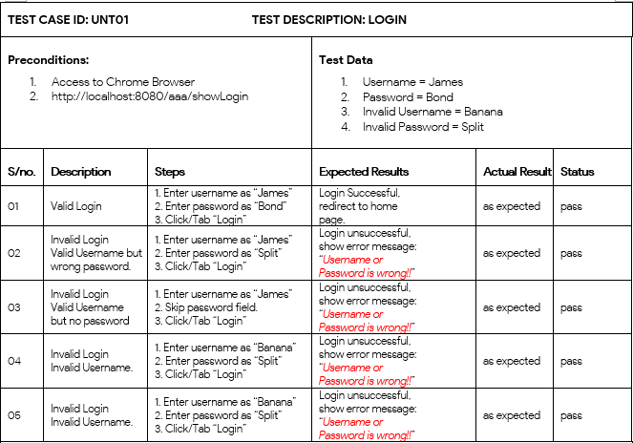
5. Test Results

Slide 18
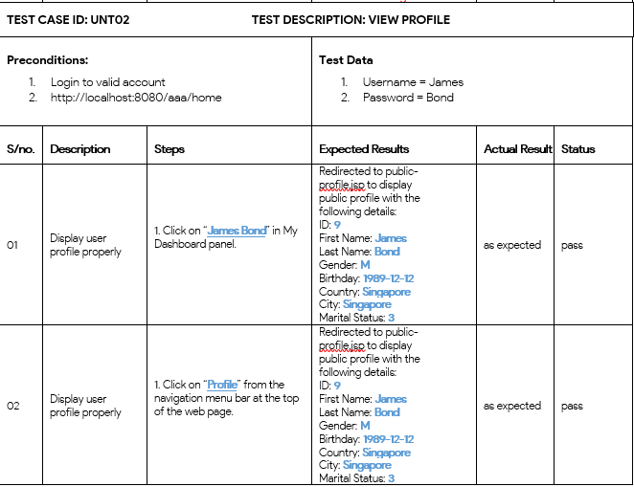
5. Test Results

Slide 19
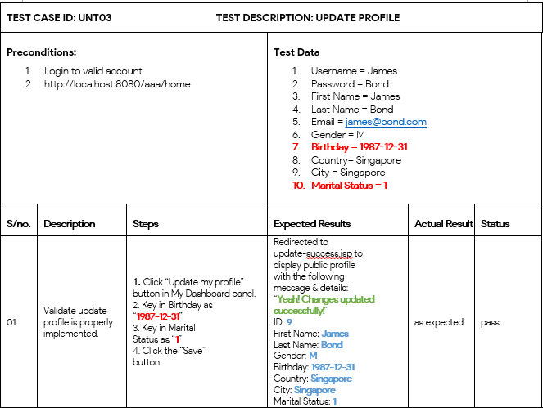
5. Test Results

Slide 20
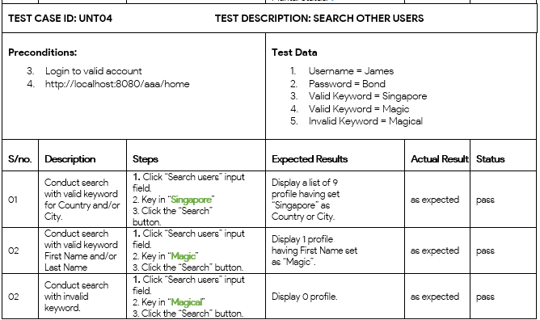
5. Test Results

Slide 21
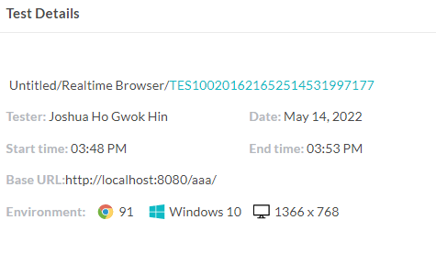
Cross Bowser Testing
5. Test Results

Slide 22
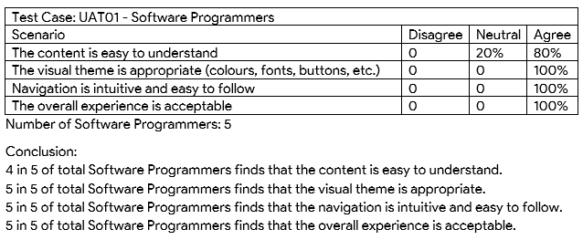
User Acceptance Testing
5. Test Results

Slide 23
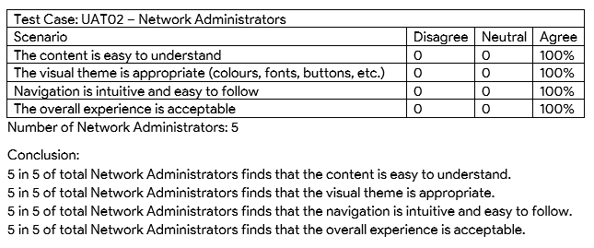
User Acceptance Testing
5. Test Results

Slide 24
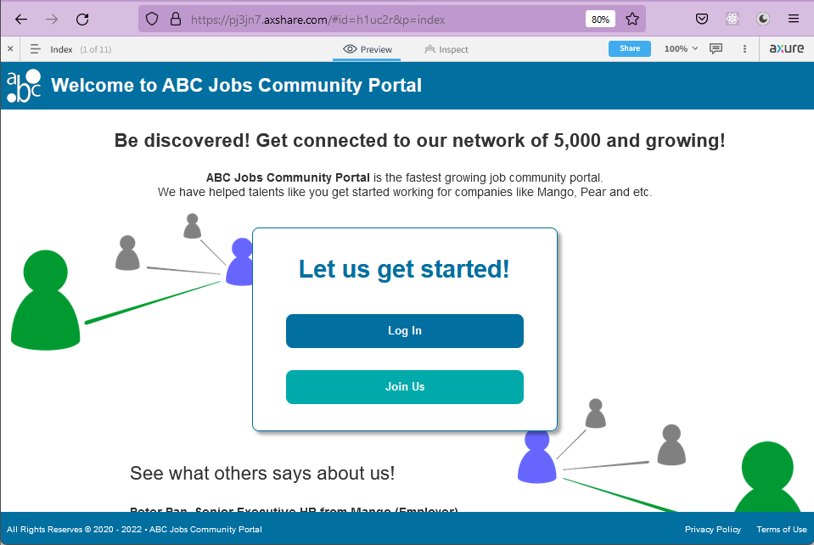
6. Testing Tools Tools
Usability Testing – www.axshare.com

Slide 25
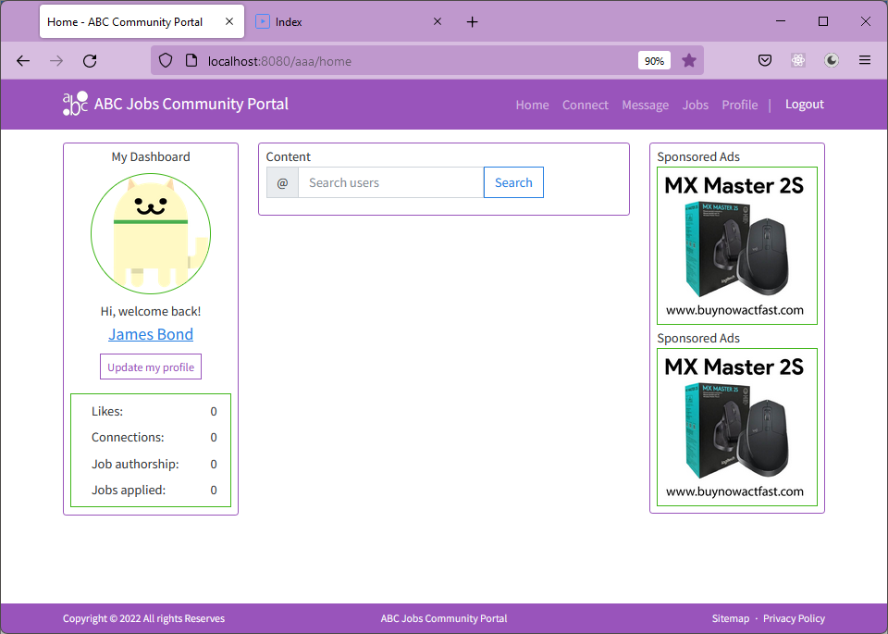
6. Testing Tools Tools
Unit Testing – firefox browser

Slide 26
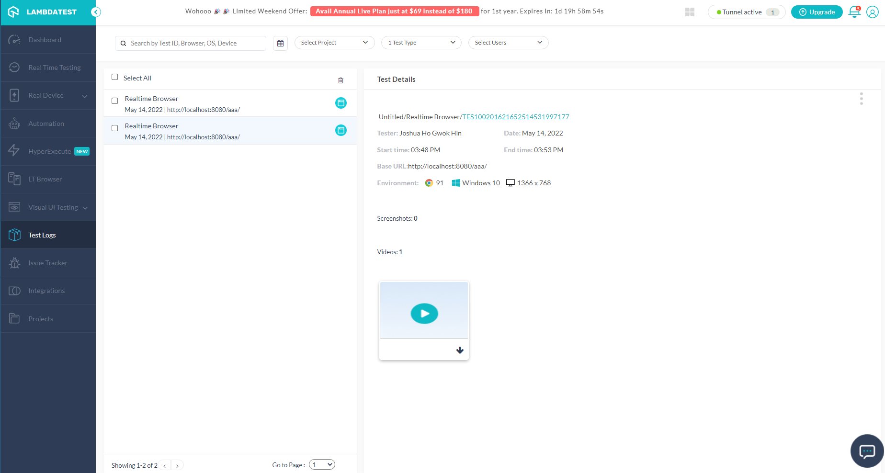
6. Testing Tools Tools
Cross Browser Testing - www.lambdatest.com

Slide 27
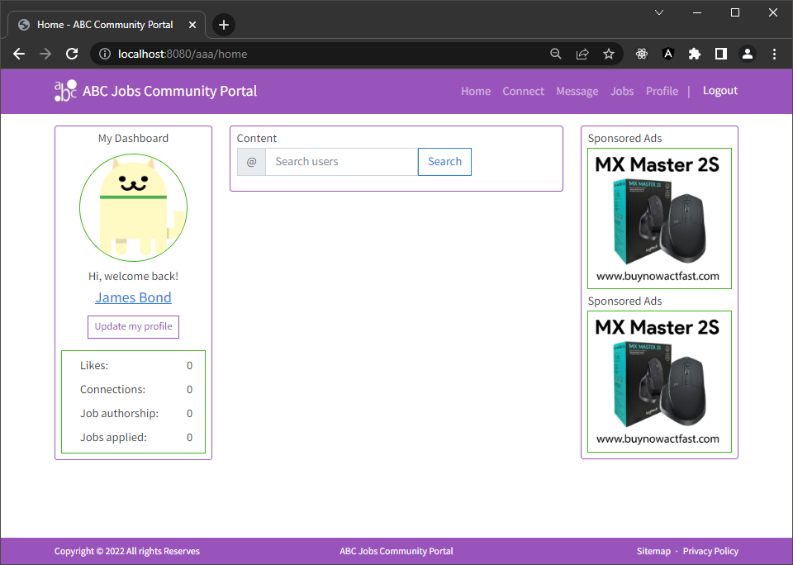
6. Testing Tools Tools
User Acceptance Testing – any compatible browser

Slide 28
7. Project Milestones & Tasks
Project Task ID | Project Task Description | Project Milestone ID
1 | Analyze and suggest choice of Test Methods | 1
2 | Schedule the Test Optimally | 1
3 | Develop the Phase Test Plan | 1
5 | Develop Test Cases & Scripts | 2
6 | Execute the Tests & Document the results | 3

Slide 29
8. Milestone Feedback & Action taken
Project Milestone ID | Milestone Feedback received from Tutor / Learning Facilitator | Action Taken (Yes / No)
1
2
3

Slide 30
9. Modifications Made based On Feedback

Slide 31
10. Project Results

Slide 32
11. Proposed Improvements
List of Improvements
<List areas of improvement which you have identified after completion of the project>
……
……
……
……
……
……

